Slide 1
Eniac’s going to Brazil - Magist Analysis
Group 4
Vaishali + Stas + Yan

Slide 2
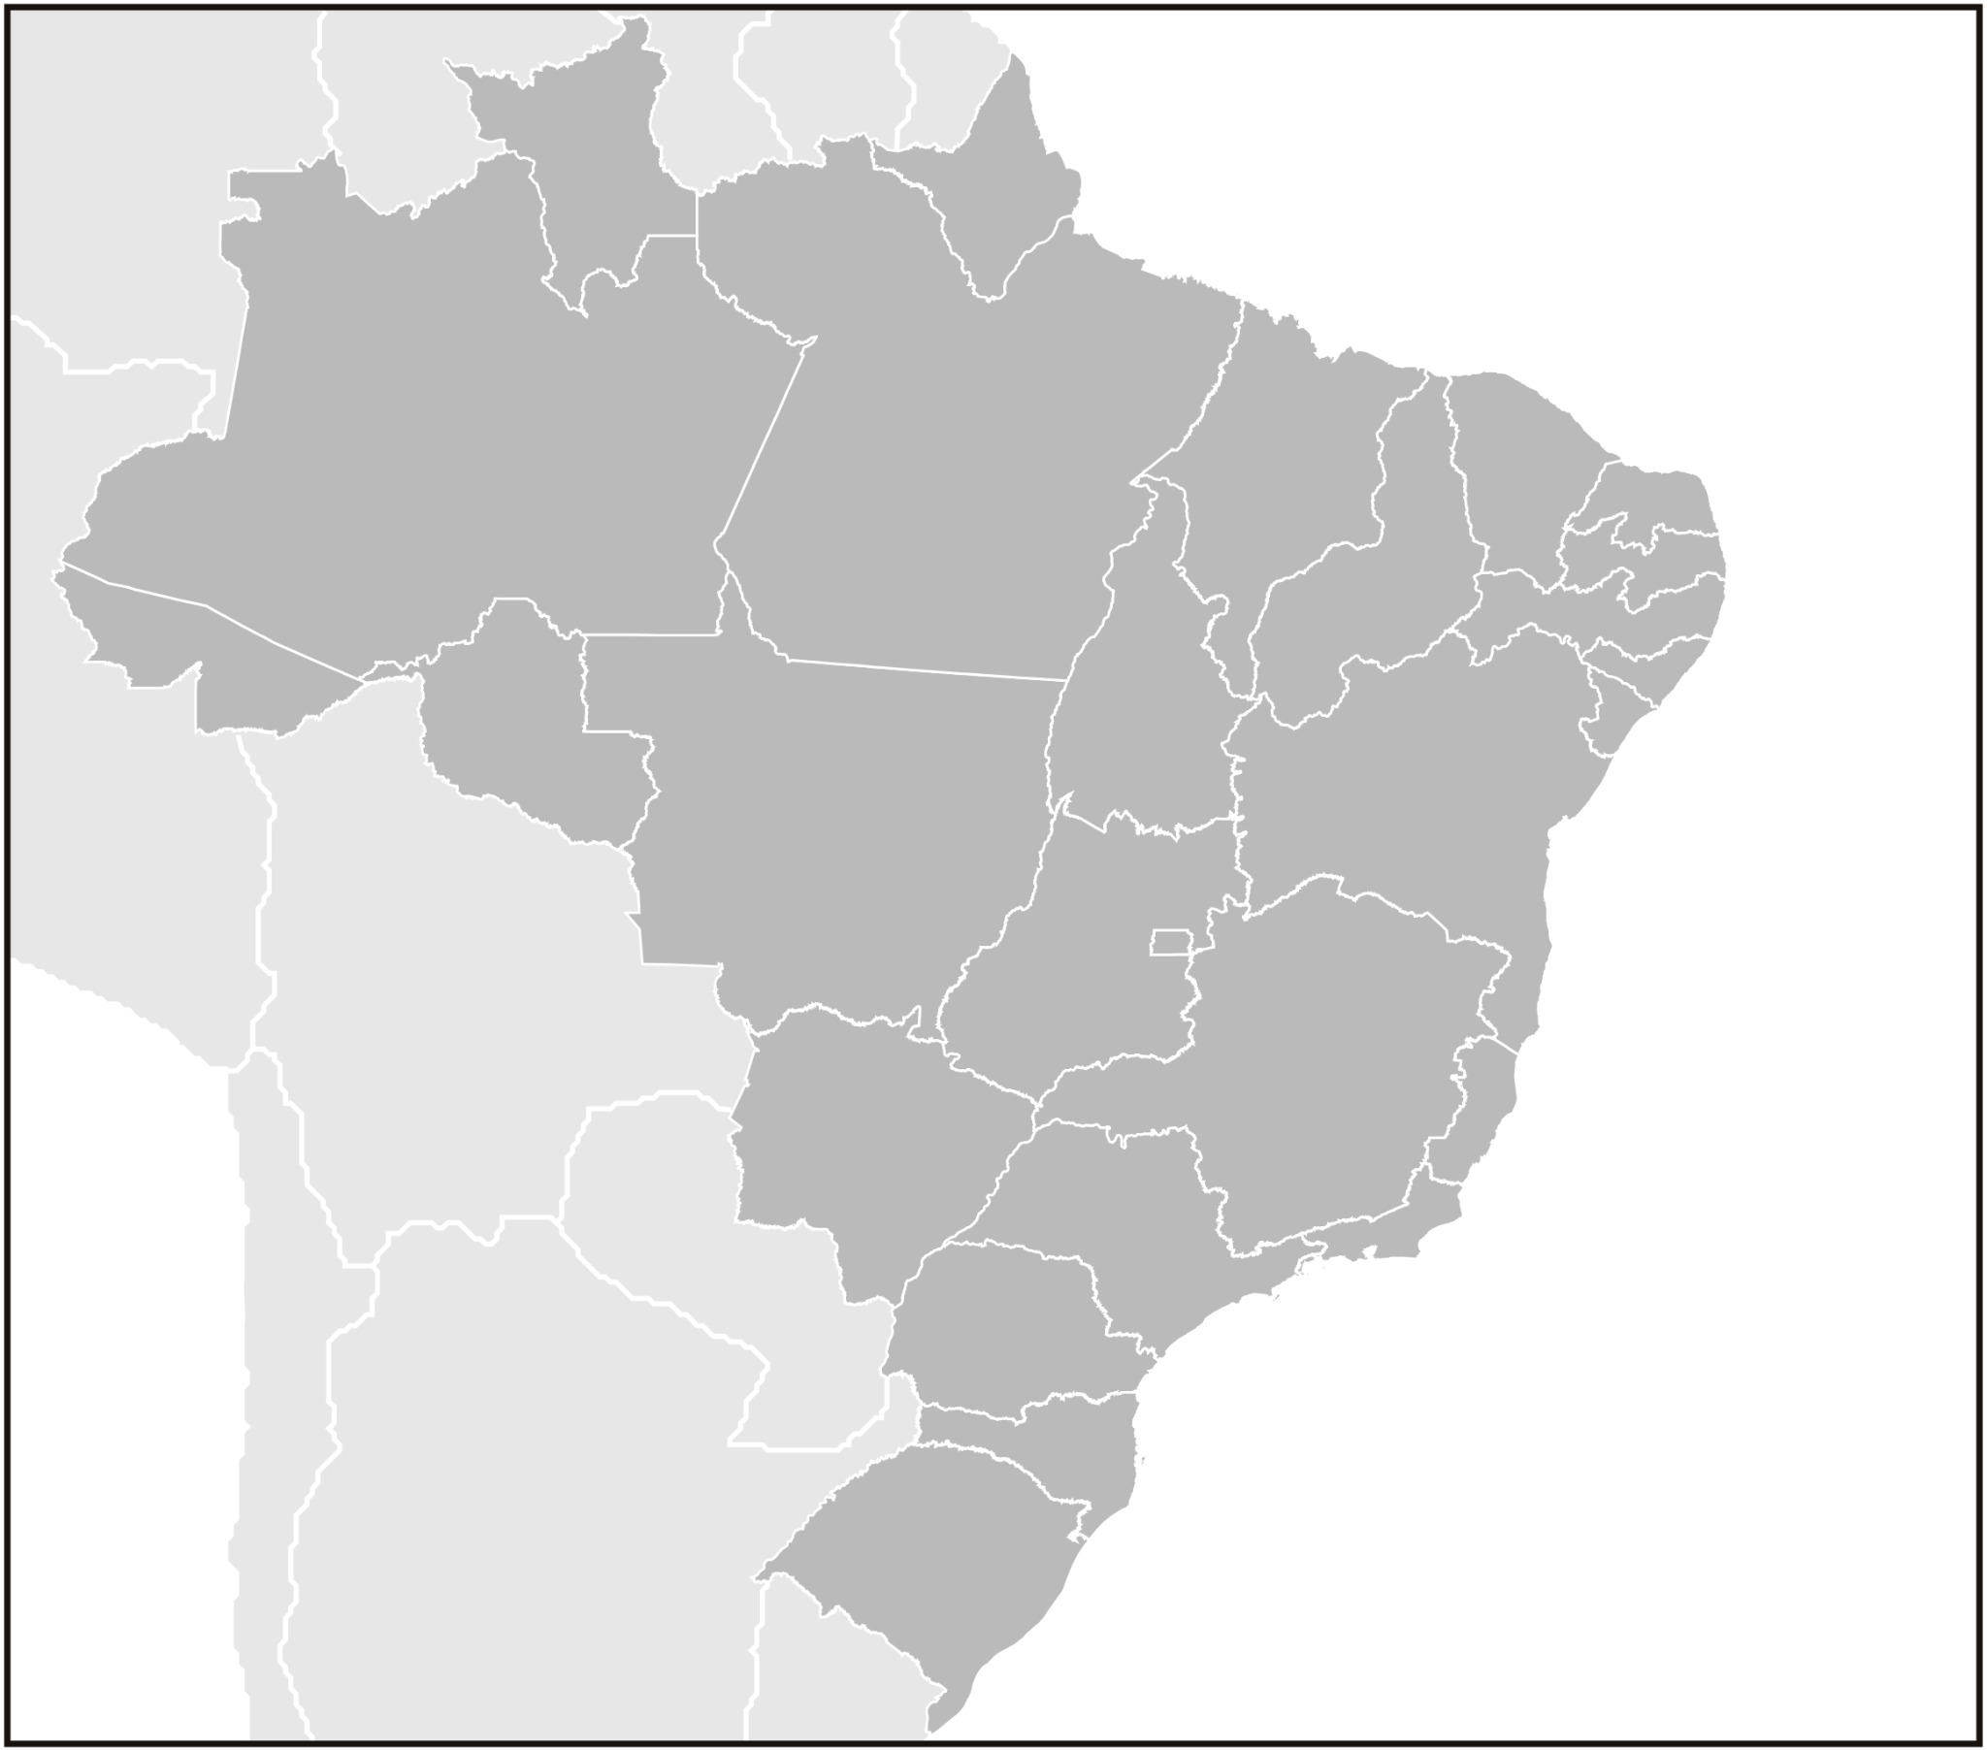
We want to bring our successful story to Brazil by offering our high-end tech products, focusing on Apple-compatible accessories.
There we will fulfill our delivery promises to our customers.
and keep 100% of customer satistications!
-
Is Magist a good fit for our high-end tech products?
Can Magist deliver our offers on time to keep our customers happy?

Slide 3
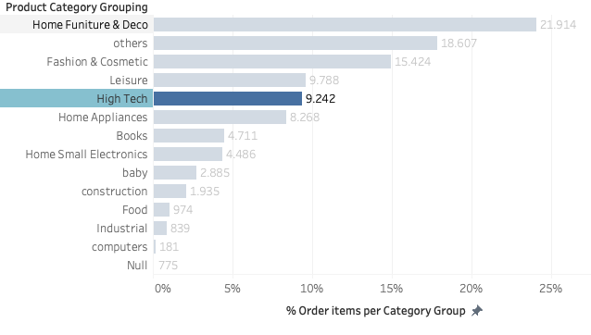
Magist’s Overview (2016 - 2018)
32,951
Products
71
Diverse Categories
3,095
Sellers
~ 8M
Annual Revenue
~9%
High-Tech Product*
40%
Home Furniture & Decoration and Fashion & Cosmetic
*high tech products are defined as computers_accessories, electronics, pc_gamer
Eniac’s catalog is 100% tech products, and heavily based on Apple-compatible accessories. Is Magist a good fit for us?
Notes:
'15,397,738
Revenue of high tech '1,317,238

Slide 4
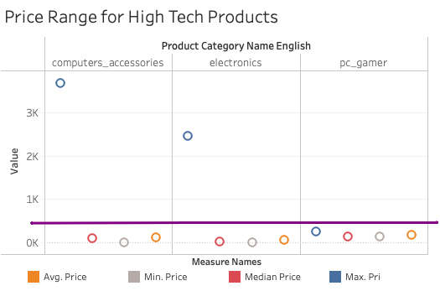
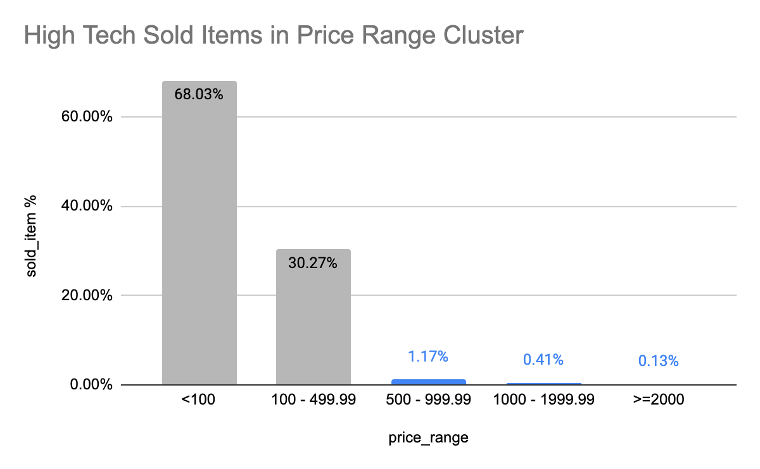
Price Point of Magist’s Products
500 EURO
Magist’s avg price in high tech products is 120 euro
The Majority of high Tech Products that Magist sold are <500 euro
*high tech products are defined as computers_accessories, electronics, pc_gamer
Eniac’s catalog is 100% tech products, and heavily based on Apple-compatible accessories. Is Magist a good fit for us?

Slide 5
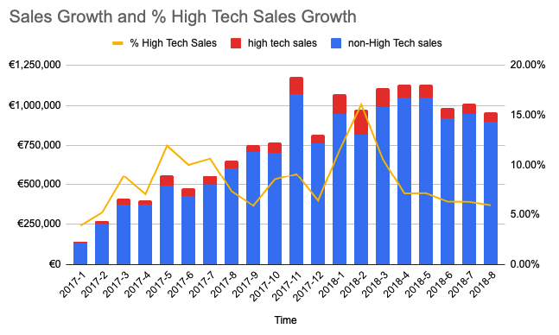
High Tech Sales Potential through Magist
No clear indications that the high Tech Products sales were picking up in Magist over time
Eniac’s catalog is 100% tech products, and heavily based on Apple-compatible accessories. Is Magist a good fit for us?
Notes:
The overall sales of Magist grow 6 times in two years by 2018 however the % of high tech sales remained below 10%. There is no indication that the demand of the high end products were picking up on their platform

Slide 6

Delivery Status of Magist (2016 - 2018)
93% of the Magist’s Deliveries are on time
The Avg delivery time is 12 days.
The Maximum delivery time could be up to 96 days.
Fast deliveries and happy customers are key for us. Are orders delivered on time with Magist?

Slide 7
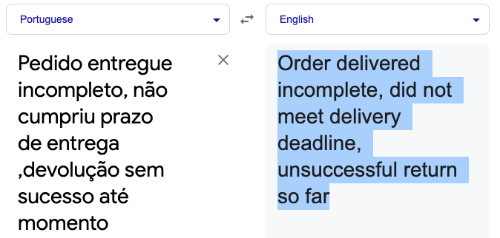
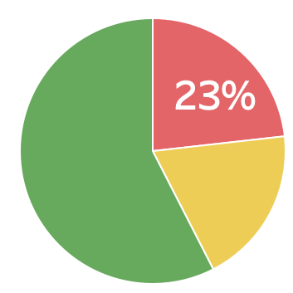

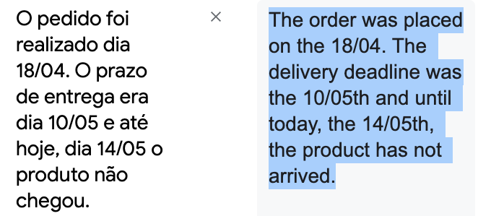
Customer Satisfaction overall: Magist (2016 - 2018)
only 77% of the Magist’s reviews are >3 (out of 5)**
30+ complaints with regards to delivery in 2018 only*
*high tech products are defined as computers_accessories, electronics, pc_gamer
**from in average 49K reviews (years 2017, 2018)
Fast deliveries and happy customers are key for us. Are orders delivered on time with Magist?
Notes:
Fast deliveries and happy customers are key for us. Are orders delivered on time with Magist?
Graph, left hand side:
Customers feedback in terms of review reveals that the vast majority of customers with is 95 % is satisfied with the platform and gives it more than 3 score stares out of 5 possible.
To provide additional data with regards to delivery satisfaction in the relevant for us categories, we could find more than 30 that are mentioning delivery issues.
One of the important point for customers is delivery.

Slide 8


Conclusion based on numbers: overview
 | Magist | Eniac (benchmark)
(High-end) tech products sales | ~9% | 100%
Avg item price | 120 euro | 540 euro
Avg delivery time | 12 days | 16 days*
Customer satisfaction | 77 % | 100%
*Average delivery time for an online order in Brazil as of March and May 2020 is 16 - 21 days (source: statista)
Is Magist a good fit for our high-end tech products?
Can Magist deliver our offers on time to keep our customers happy?
Concerns: Is Magist a good fit for our high-end tech products?
Can Magist deliver our offers on time to keep our customers happy?
Notes:
What is to mention/repeat here again: clear in plane words but with numbers
Two burning questions or rather concerned we want to answer with this brief presentation are: “Is Magist a good fit for our high-end tech products?” and “Can Magist deliver our offers on time to keep our customers happy?”
The two first rows of the presented table here address the concern with regards to whether or not Magist is a good fit for Eniac as we only deal with high-end tech products. Based on the database provided from Magist it could be concluded, that the platform only deals with 10% of tech products including high-end tech products. The average price of those products is 120€, which is significantly lower than the average item price at our company.
The last two rows of this table deal with customer satisfaction. Here we have looked into delivery times and potential issues regarding that and the scores that customers gave Magist.
The delivery time is below the minimum that we require as a company and therefore fits within our 16 day requirement.
However throughout 2018 there are being a growing number of complaints regarding delivery.
and based on the customer comments there are growing number of complaints with regard to the delivery being

Slide 9
THANK YOU

Slide 10
Recap After Presentation
What did we miss? Content wise? Presentation Wise

Slide 11
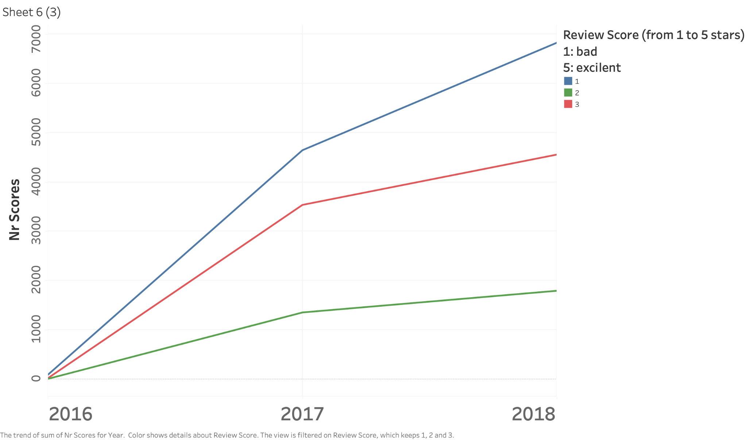
Appendix

Slide 12
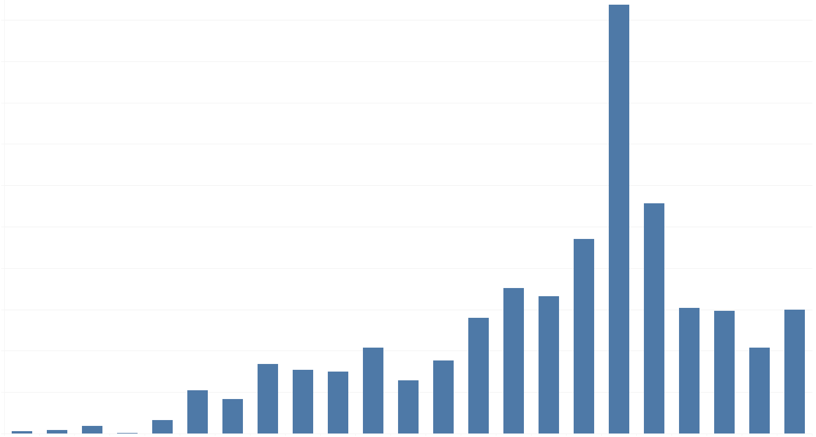
Customer Satisfaction for relevant categories: Magist (2016 - 2018)*
5.2 %
Fraction of NOT satisfied customers [%]
2016
2017
2018
2018-07
95-98% of the Magist’s reviews are >3 (out of 5)
30+ complaints with regards to delivery in 2018 only
Fast deliveries and happy customers are key for us. Are orders delivered on time with Magist?
*high tech products are defined as computers_accessories, electronics, pc_gamer
Notes:
Fast deliveries and happy customers are key for us. Are orders delivered on time with Magist?
Graph, left hand side:
Customers feedback in terms of review reveals that the vast majority of customers with is 95 % is satisfied with the platform and gives it more than 3 score stares out of 5 possible.
To provide additional data with regards to delivery satisfaction in the relevant for us categories, we could find more than 30 that are mentioning delivery issues.
One of the important point for customers is delivery.

Slide 13
Customer Satisfaction overall: Magist (2016 - 2018)
only 77% of the Magist’s reviews are >3 (out of 5)**
30+ complaints with regards to delivery in 2018 only*
Fast deliveries and happy customers are key for us. Are orders delivered on time with Magist?
*product categories: computers accessories, electronics, pc gamer
**from in average 49K reviews (years 2017, 2018)
Notes:
Fast deliveries and happy customers are the priority for us. Are all the orders delivered on time with Magist?
Pie chart, left hand side:
The chart shows customer feedback in terms of reviews within a 5 star score system of the platform. Green represents 5 star and yellow 4 star reviews which accumulates to 77% of the total customer reviews.
Customers feedback in terms of review reveals that the vast majority of customers with is 95 % is satisfied with the platform and gives it more than 3 score stares out of 5 possible.
3 star or less is represented in the chart by red. As you can see this accumulates to 23%.
To provide additional data with regards to delivery satisfaction in the relevant for us categories, we could find more than 30 that are mentioning delivery issues.
One of the important point for customers is delivery.

Slide 14
Here are some numbers that will help you understand Eniac’s scope (data from April 2017 – March 2018):
Revenue: 40,044,542 €
Avg monthly revenue: 1,011,256 €
Avg order price: 710 €
Avg item price: 540 €
Fast deliveries and happy customers are key for us. Are orders delivered on time with Magist?

Slide 15
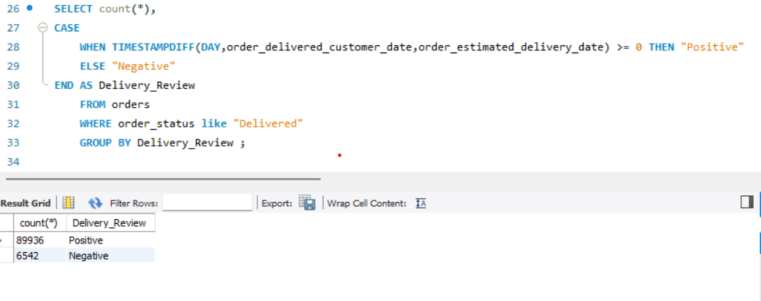
Delivery Status of Magist
Our Conclusion : Overall delivery results of Magist is Very positive . They have delivered on time or before estimated delivery time in 93.2% of the cases

Slide 16
Conclusion based on numbers: overview
 | Magist | Eniac (benchmark)
(High-end) tech products sales | ~9% | 100%
Avg item price | 120 euro | 540 euro
Avg delivery time | 12 days | 16 days*
Customer satisfaction | 95 - 98% | 100%
*Average delivery time for an online order in Brazil as of March and May 2020 is 16 - 21 days (source: statista)
Is Magist a good fit for our high-end tech products?
Can Magist deliver our offers on time to keep our customers happy?
Notes:
What is to mention/repeat here again: clear in plane words but with numbers
Two burning questions or rather concerned we want to answer with this brief presentation are: “Is Magist a good fit for our high-end tech products?” and “Can Magist deliver our offers on time to keep our customers happy?”
Two first rows of the presented table here addressing the concern with regards to whether or not Magist is a good fit for Eniac as we only deal with high-end tech products. Based on the database provided from Magist could be concluded, that the platform only deals with roughly 9% of tech products including high-end tech products. The average price of those products is 120€, which is significantly below the average item price at our company.
The last two rows of this table deal with the customer satisfaction. Here we have looked into delivery times and potential issues with those and the scores that customer gave Magist.
The delivery time is below the minimum that we require as a company and therefore fits within our 16 day requirement.

